Slide 1

DEEP NEURAL NETWORK MODULE # 3 : LINEAR NEURAL NETWORKS FOR REGRESSION
DNN Team
BITS Pilani WILP

Slide 2
The instructor is gratefully acknowledging the authors who made their course materials freely available online.
This deck is prepared by Seetha Parameswaran.
Deep Learning

Slide 3








Table of Contents
Regression
Linear Regression
The Linear Model: Single Neuron
Worked Example
Evaluation
Python Implementation Implementation Tips
Summary
1
2
3
4
5
6
7
8
Deep Learning

Slide 4
What is Regression?
Definition
Regression is a supervised learning task that predicts a continuous-valued output based on input features.
Key Characteristics:
Input: Feature vector x ∈ R^{d}
Output: Real-valued target y ∈ R
Goal: Learn a function f : R^{d} → R such that y ≈ f (x)
Deep Learning

Slide 5
Examples of Regression Problems
House Price Prediction
Input: Size, location, number of rooms
Output: Price in dollars
Temperature Forecasting
Input: Historical weather data, season, humidity
Output: Temperature in degrees
Stock Price Prediction
Input: Historical prices, trading volume, market indicators
Output: Future stock price
1
2
3
Deep Learning

Slide 6


Table of Contents
Regression
Linear Regression
The Linear Model: Single Neuron
Worked Example
Evaluation
Python Implementation Implementation Tips
Summary
1
2
3
4
5
6
7
8
Deep Learning

Slide 7
What is Linear Regression?
Definition
Linear regression assumes the output is a linear combination of the input features.
Mathematical Form:
y = w₀ + w₁x₁ + w₂x₂ + · · · + w_{d}x_{d}
(1)
where:
x = [x₁, x₂, . . . , x_{d} ]^{T} are the input features
w = [w₁, w₂, . . . , w_{d} ]^{T} are the weights
w₀ is the bias term
Deep Learning

Slide 8
Examples of Linear Regression
1
Salary Prediction
Salary = w₀ + w₁ × Years of Experience
2
Crop Yield Prediction
Yield = w₀ + w₁ × Rainfall + w₂ × Fertilizer
3
Energy Consumption
Energy = w₀ + w₁ × Temperature + w₂ × Hour + w₃ × Day
The relationship between inputs and output is assumed to be linear.
Deep Learning

Slide 9
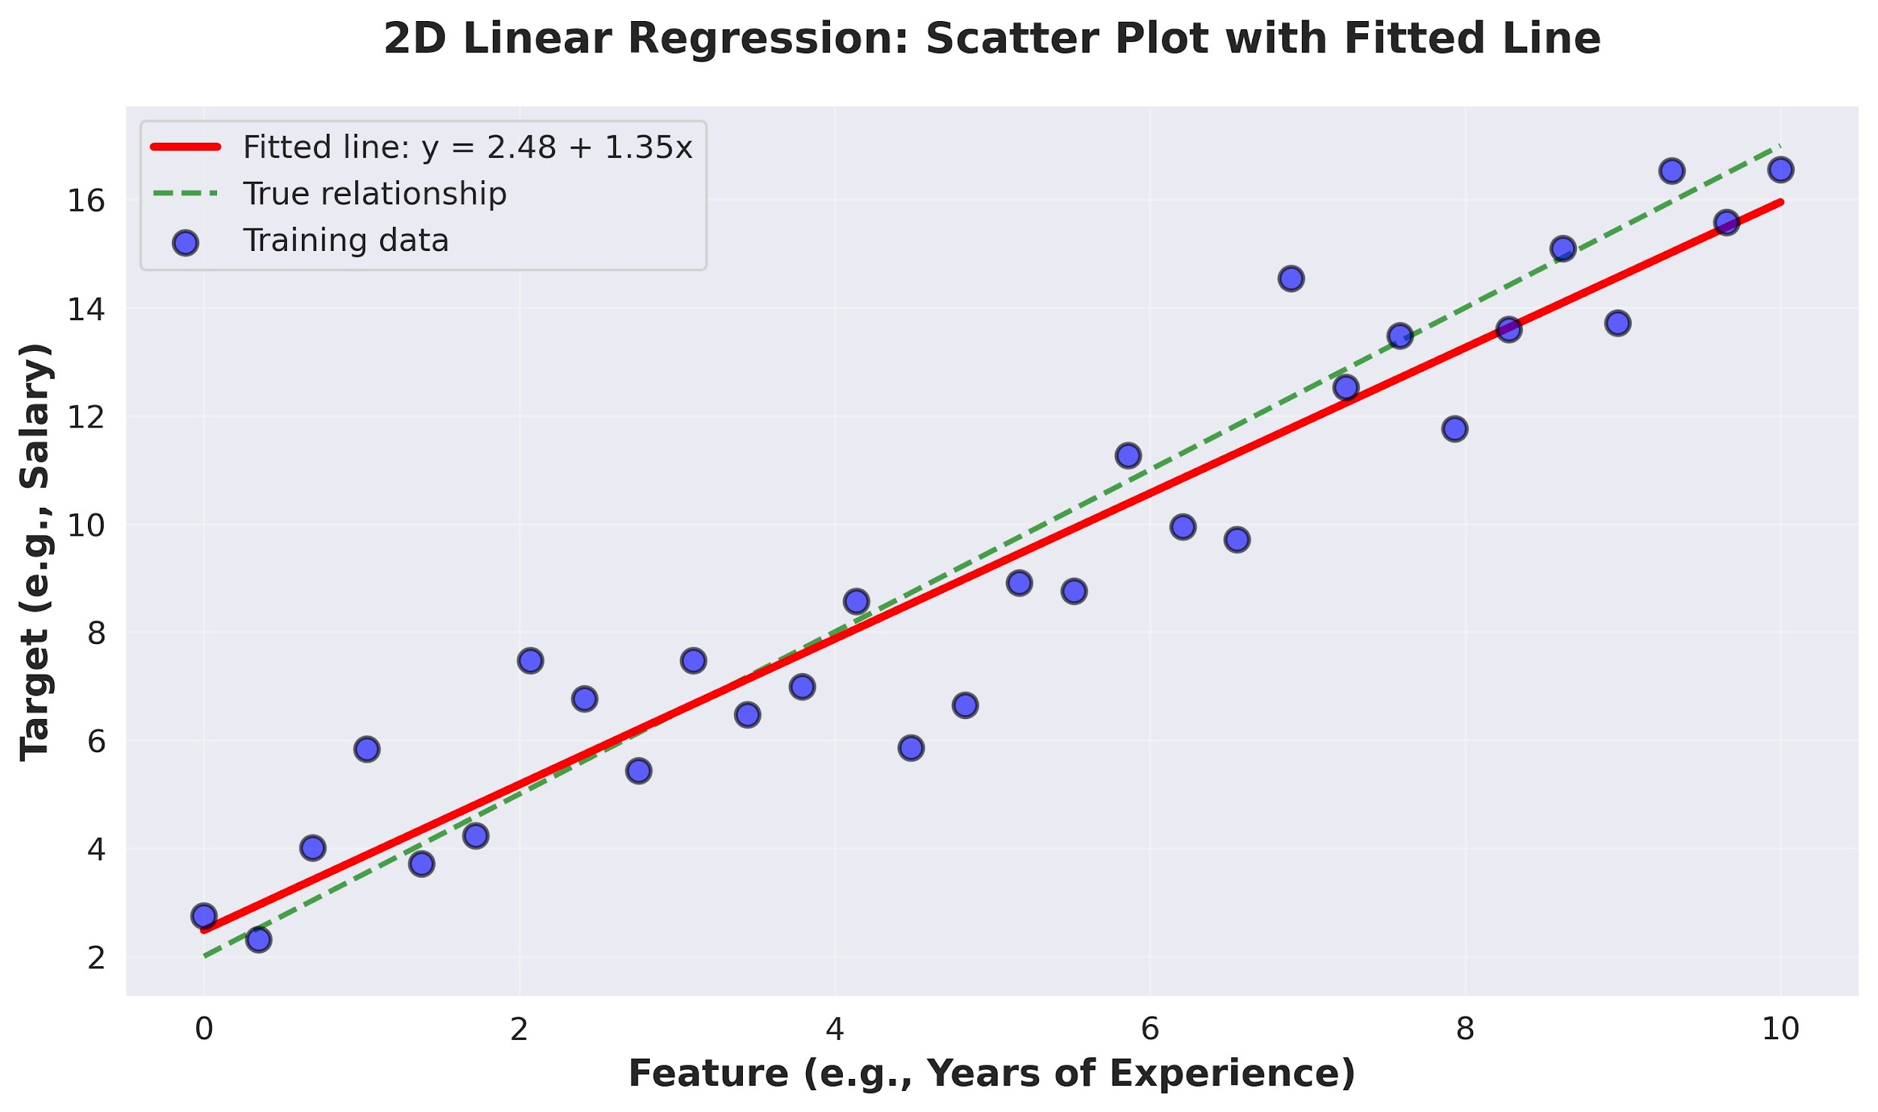
Visual Example: 2D Linear Regression
Deep Learning

Slide 10

Table of Contents
Regression
Linear Regression
The Linear Model: Single Neuron
Worked Example
Evaluation
Python Implementation Implementation Tips
Summary
1
2
3
4
5
6
7
8
Deep Learning

Slide 11
The Four Components
A complete machine learning system consists of:
1
Data: d -dimensional input vectors and target outputs Model: Single neuron implementing linear function Objective Function: Measures prediction error
Learning Algorithm: Gradient descent to optimize weights
2
3
4
Deep Learning

Slide 12
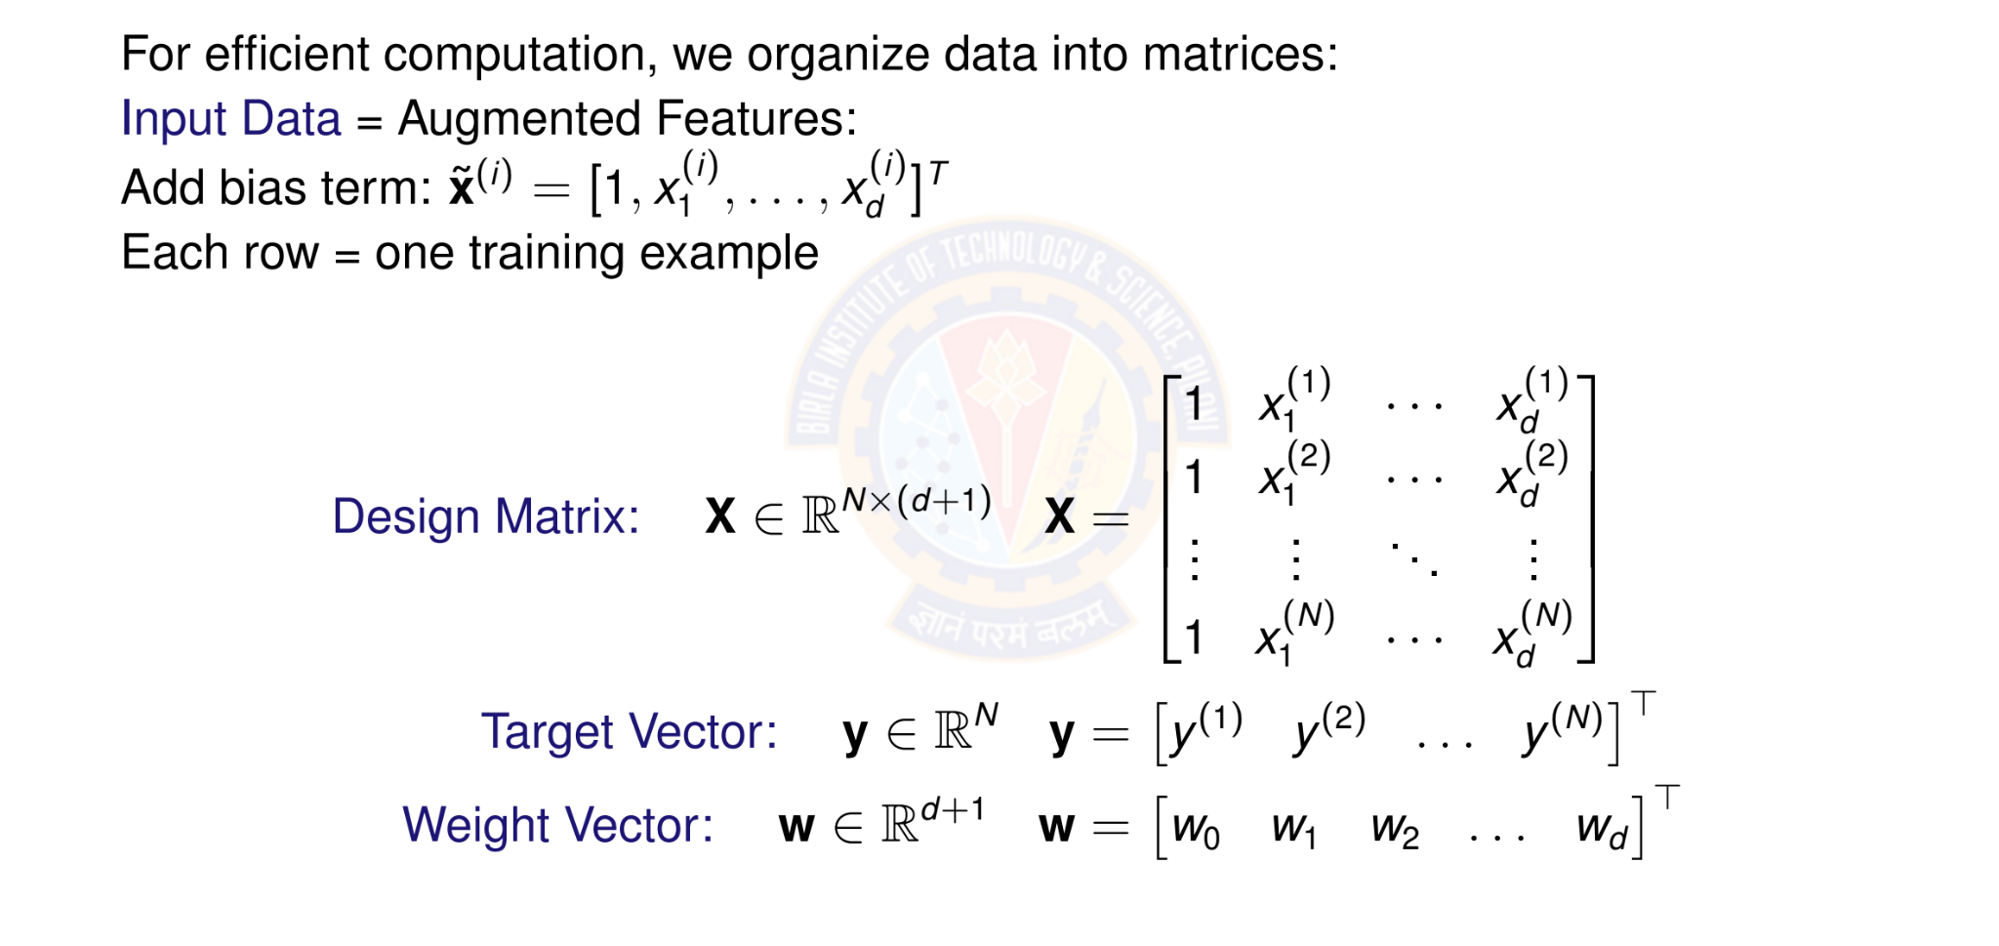
Matrix Form of Data
Deep Learning

Slide 13

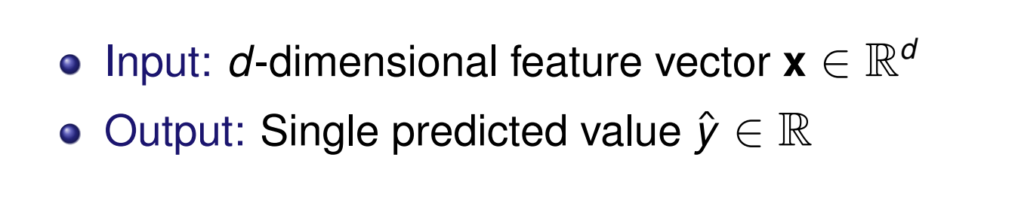
Linear Model as a Single Neuron
Model linear regression as a single artificial neuron:
1
x₁
w₀ w₁ w₂
f
Σ
y^{ˆ}
x
2
.
x_{d}
.
w_{d}
Deep Learning

Slide 14
Linear Model Prediction
Model: A single neuron computes a weighted sum and applied identity activation function.
Prediction for input x:
y^{ˆ} = f (w^{T} x) = f (w₀ + w₁x₁ + w₂x₂ + · · · + w_{d} x_{d} )
(2)
where:
w = [w₀, w₁, . . . , w_{d} ]^{T} ∈ R^{d +1} are the model parameters
x = [1, x₁, . . . , x_{d} ]^{T} ∈ R^{d +1} is the input
f (·) is the identity activation f (z) = z
Vectorized form: for all predictions
y^{ˆ} = Xw
(3)
Deep Learning

Slide 15
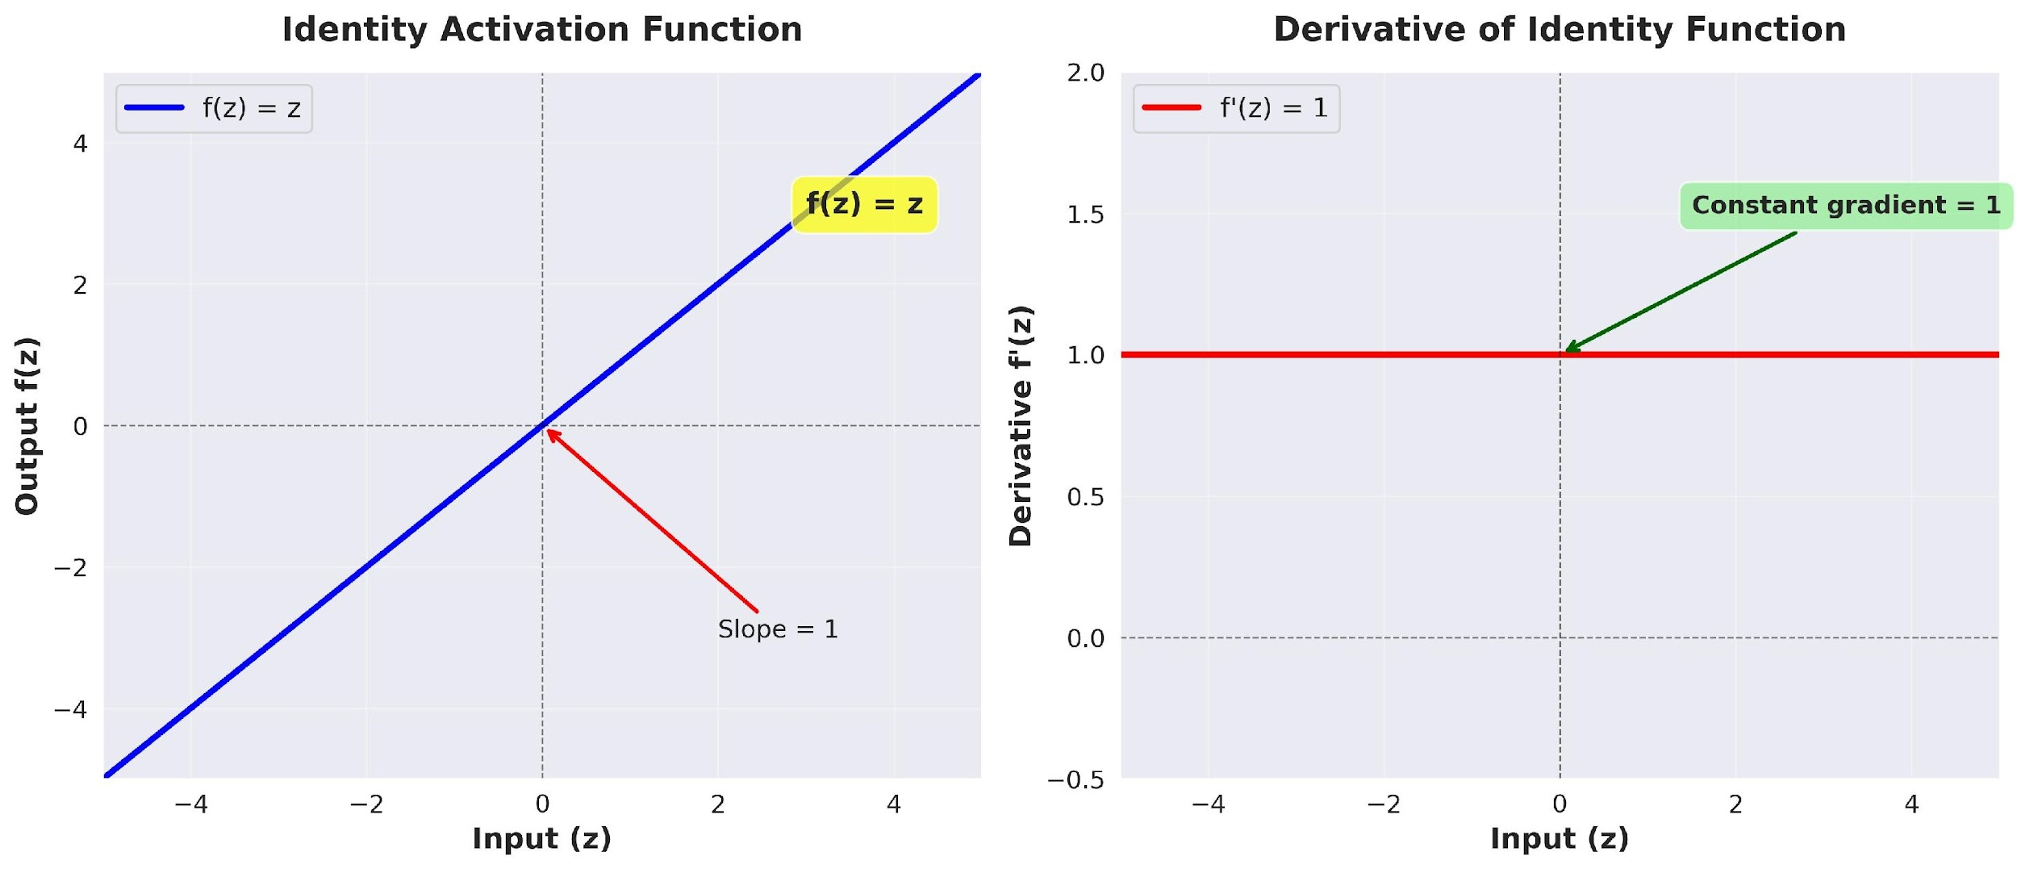
Identity Activation Function
Identity Activation Function
f (z) = z
(4)
Deep Learning

Slide 16
Identity Activation Function
Properties of Identity Function Output: Continuous, (−∞, ∞)
Differentiable everywhere: f '(z) = 1 Allows output to take any real value
Gradient flows unchanged through the neuron Perfect for predicting continuous targets
Why identity for regression?
Target values are continuous (prices, temperatures, etc.) Need to predict any real number, not just binary { 0,1 } Differentiability enables gradient-based optimization
No information loss from input to output
Deep Learning

Slide 17
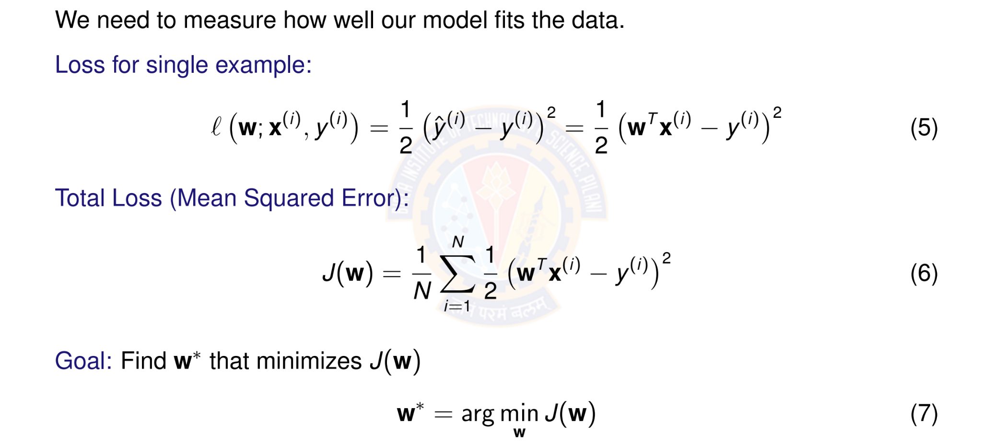
Objective Function: Squared Error Loss
Deep Learning

Slide 18
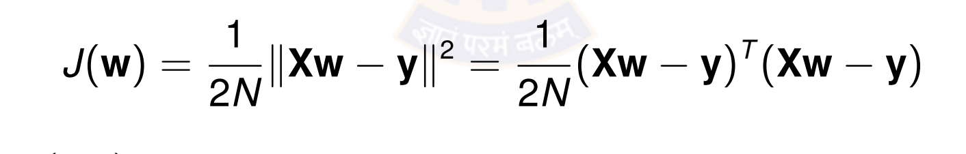
Why Squared Error?
Advantages of squared error loss:
Differentiable: Smooth everywhere, easy to optimize Convex: Single global minimum (for linear models) Penalizes large errors: Quadratic growth
Statistical interpretation: Maximum likelihood under Gaussian noise
Vector Form:
(8)
where X ∈ R^{N×(d +1)} is the design matrix and y ∈ R^{N} is the target vector.
Deep Learning

Slide 19
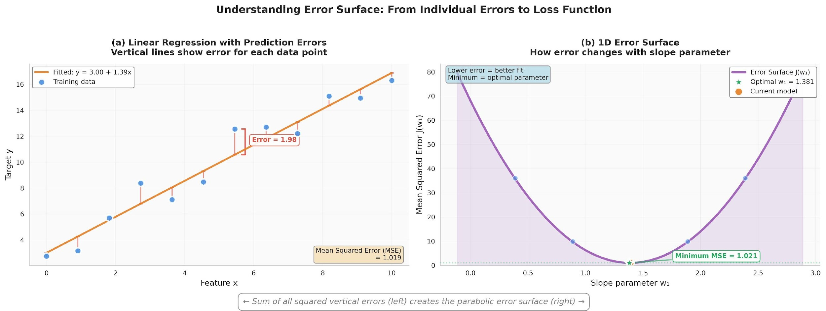
Visualizing the Error Surface
The error surface is convex with a single global minimum.
Deep Learning

Slide 20
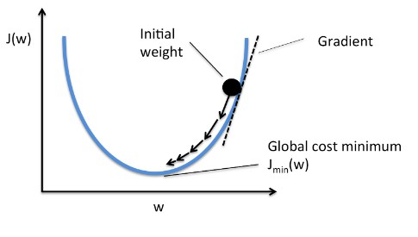
Gradient Descent Algorithm
Idea: Iteratively update weights in the direction of steepest descent
where η > 0 is the learning rate (step size).
Intuition: Move downhill on the error surface to find the minimum.
Deep Learning

Slide 21
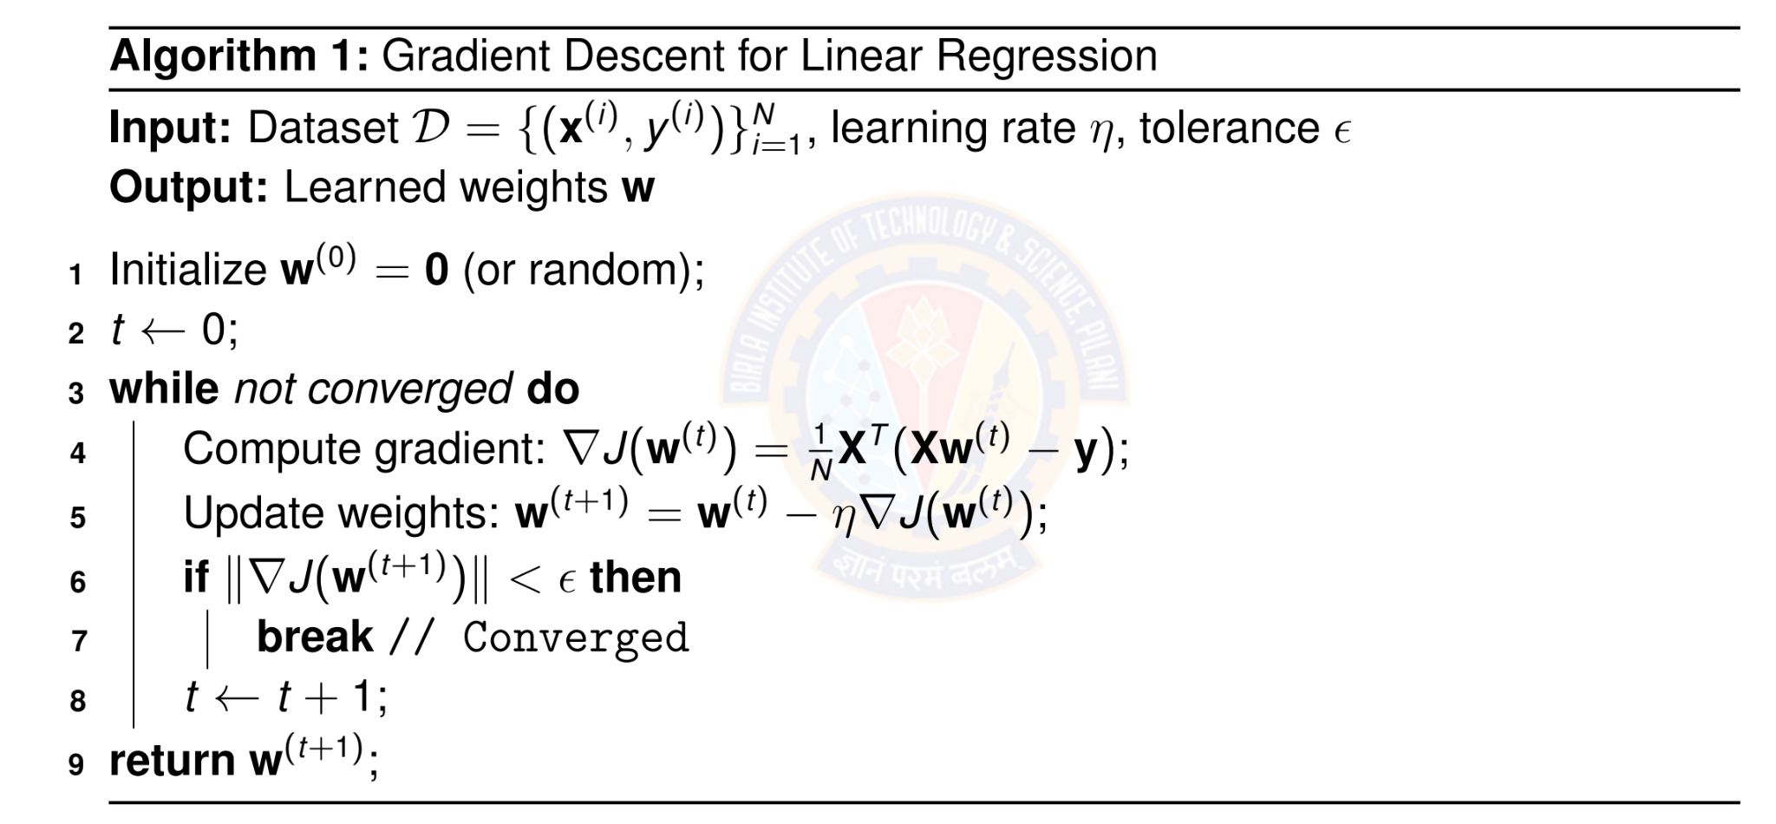
Batch Gradient Descent Algorithm
Deep Learning

Slide 22
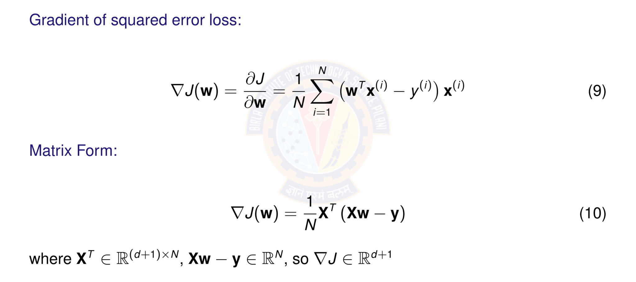
Computing the Gradient
Deep Learning

Slide 23
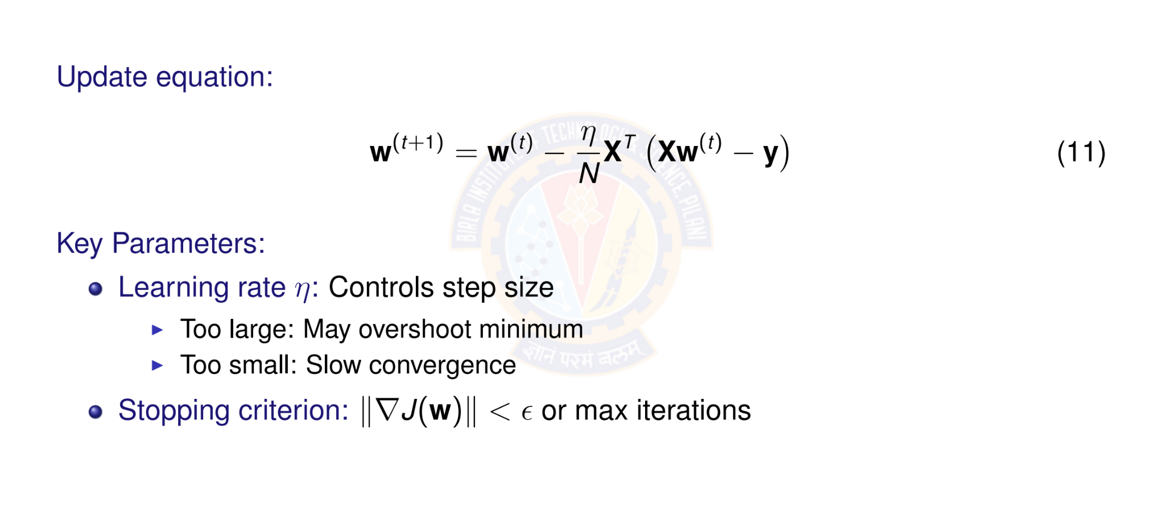
Gradient Descent Update Rule
Deep Learning

Slide 24
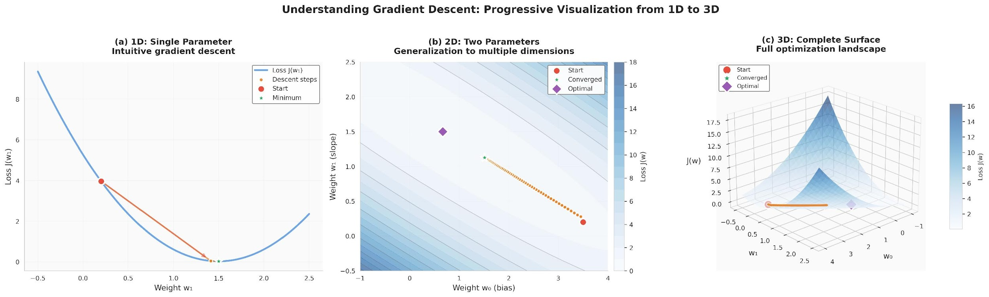
Visualizing Gradient Descent
Each step moves perpendicular to contour lines toward the minimum.
Deep Learning

Slide 25

Table of Contents
1
Regression
Linear Regression
The Linear Model: Single Neuron
Worked Example
Evaluation
Python Implementation Implementation Tips
Summary
2
3
4
5
6
7
8
Deep Learning

Slide 26
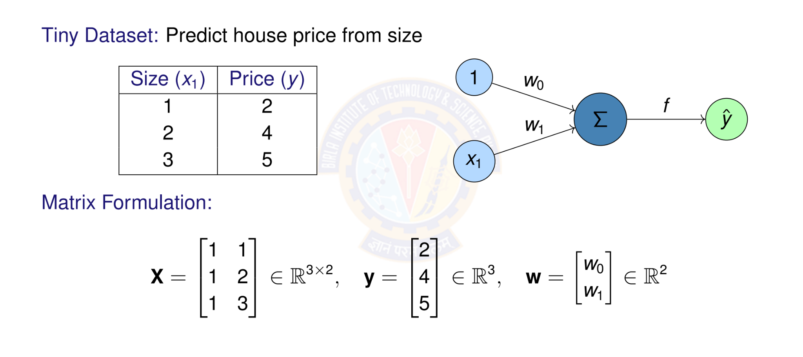
Numerical Example: Setup
Deep Learning

Slide 27
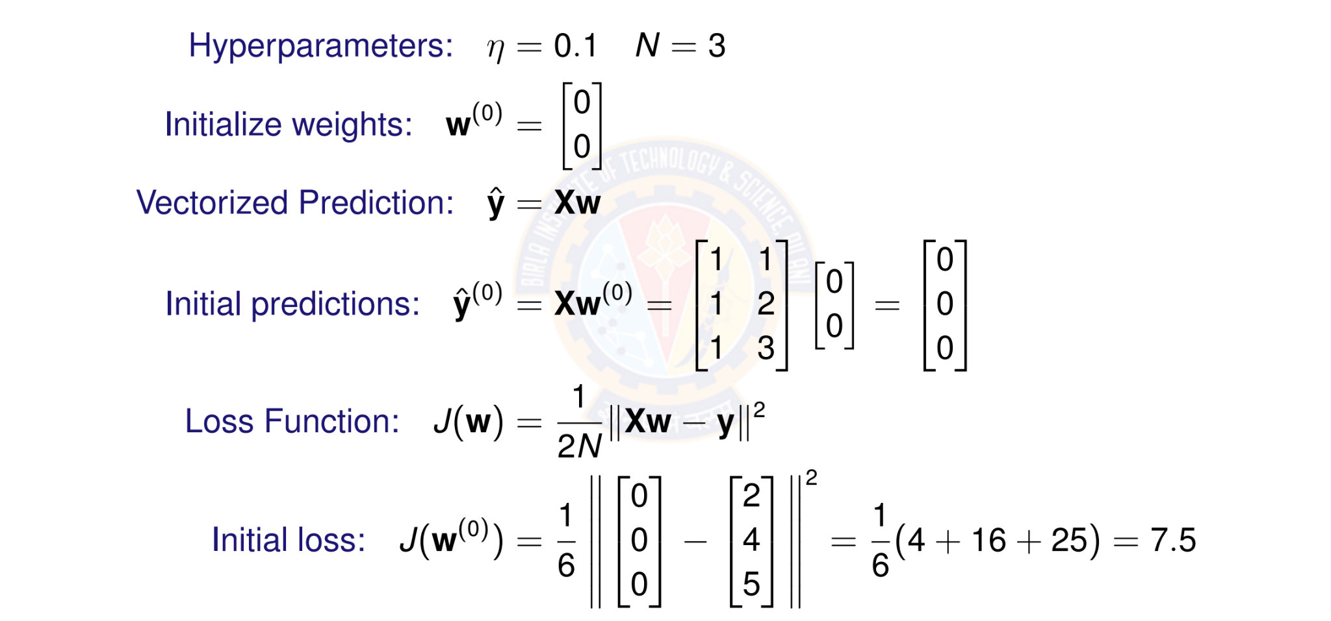
Numerical Example: Initialization
Deep Learning

Slide 28
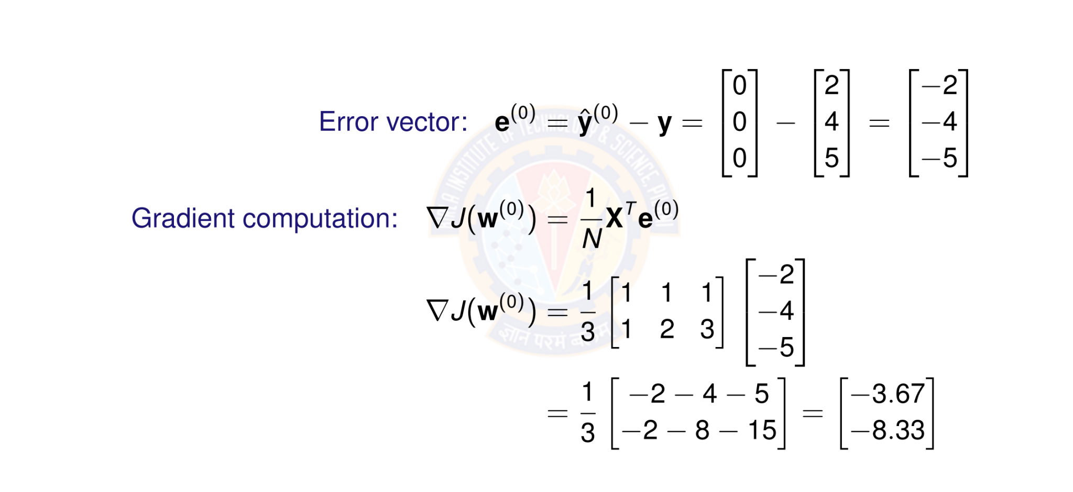
Numerical Example: Computing Gradient
Deep Learning

Slide 29
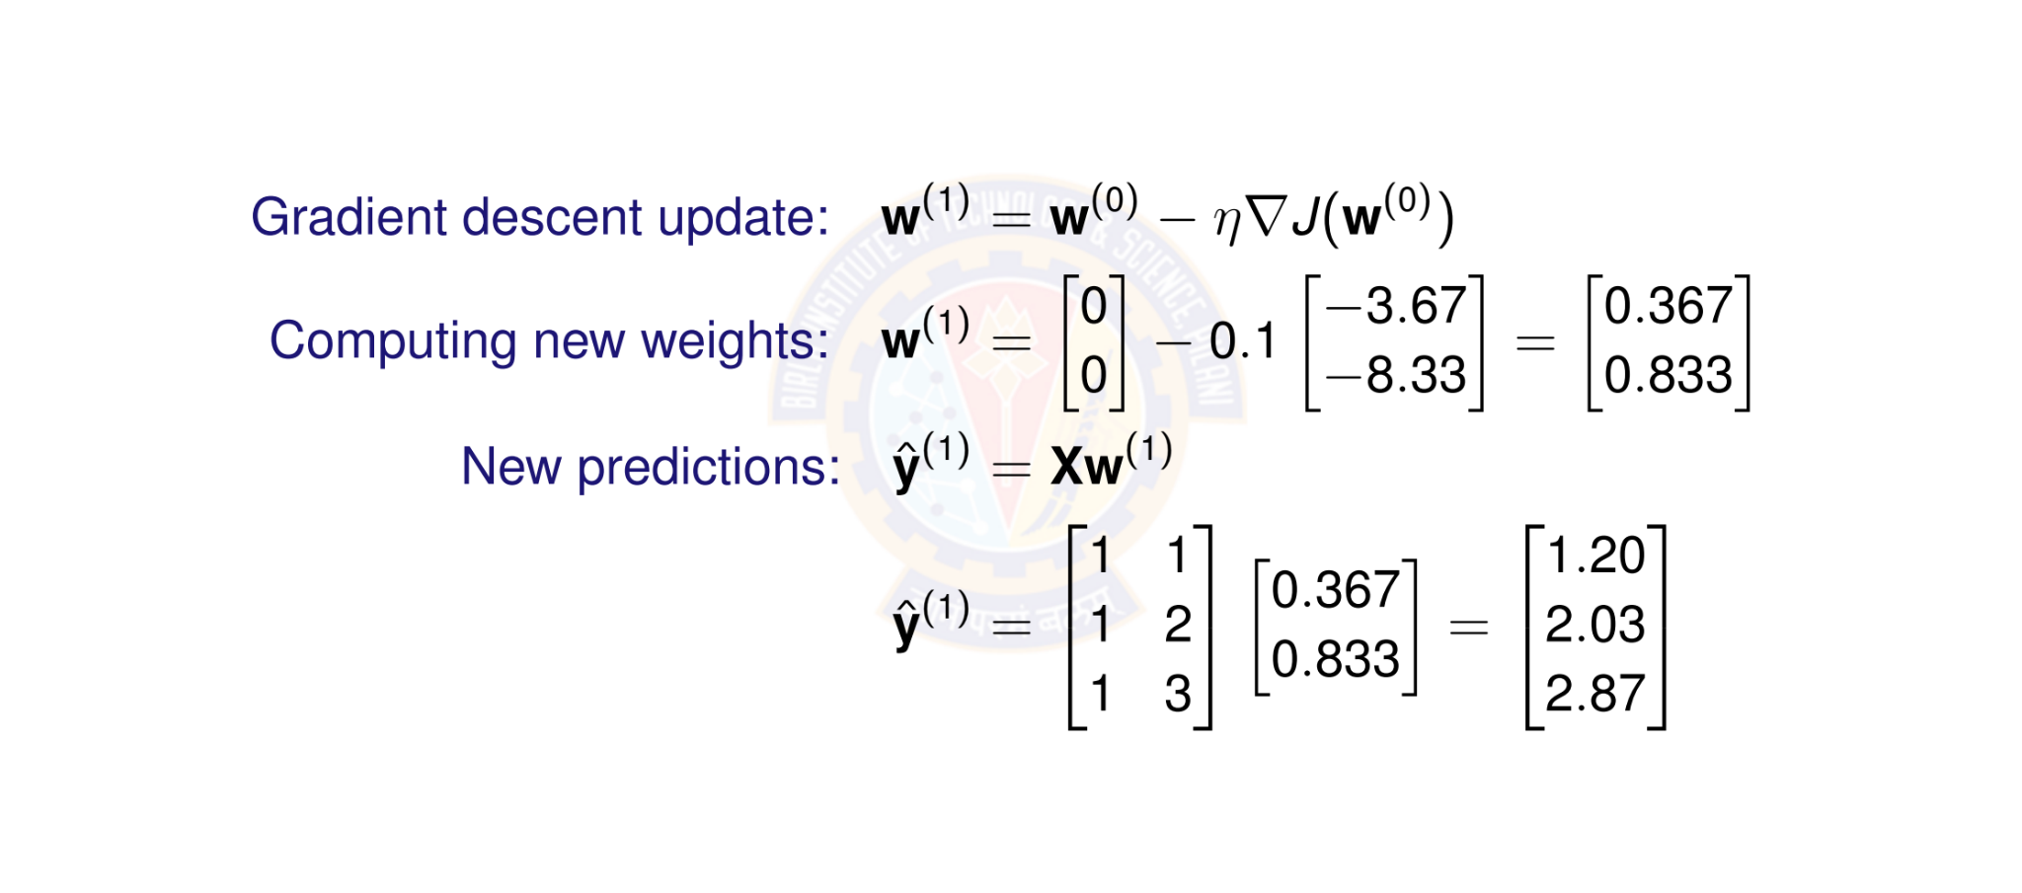
Numerical Example: Weight Update
Deep Learning

Slide 30
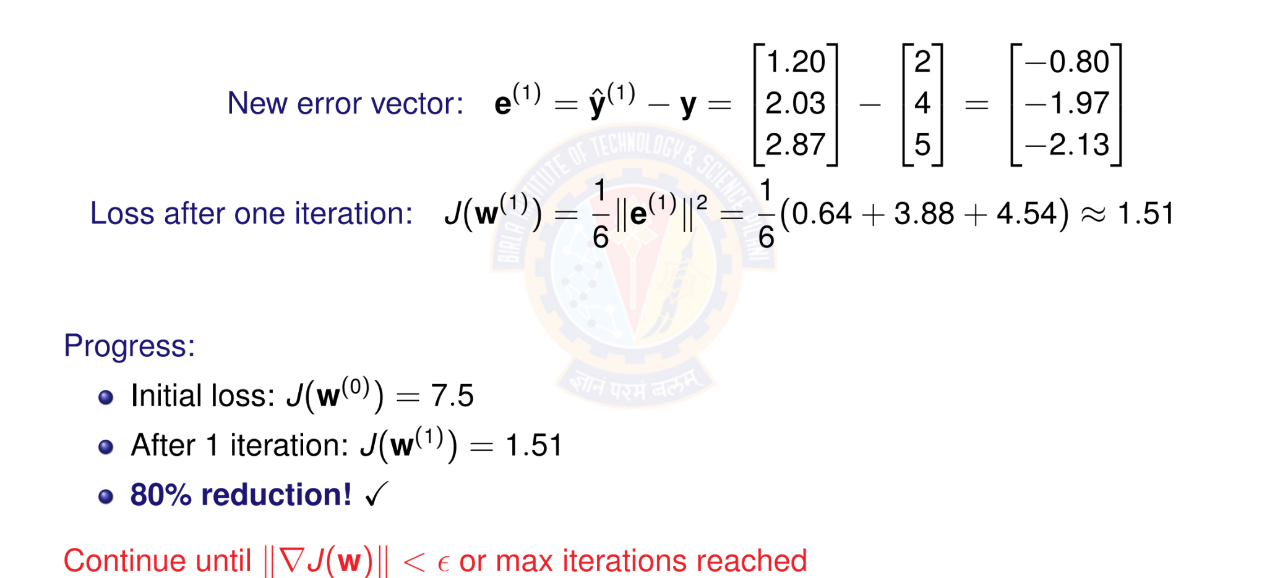
Numerical Example: New Loss
Deep Learning

Slide 31
Computational Graph for One Gradient
Parameters Input Data Targets
_{w}(t )
 | —η
X
y
Updated
_{w}(t +1)
×
∇J
_{X}T
y^{ˆ}
—
Loss
1 _{e}
∇J
N
e
·
2
J(w)
Deep Learning

Slide 32

Table of Contents
Regression
Linear Regression
The Linear Model: Single Neuron
Worked Example
Evaluation
Python Implementation Implementation Tips
Summary
1
2
3
4
5
6
7
8
Deep Learning

Slide 33
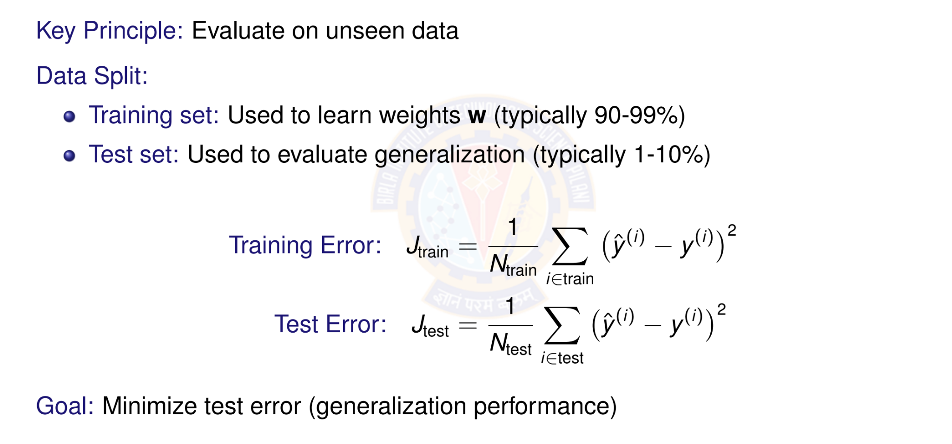
Model Evaluation: Training vs Test Error
Deep Learning

Slide 34
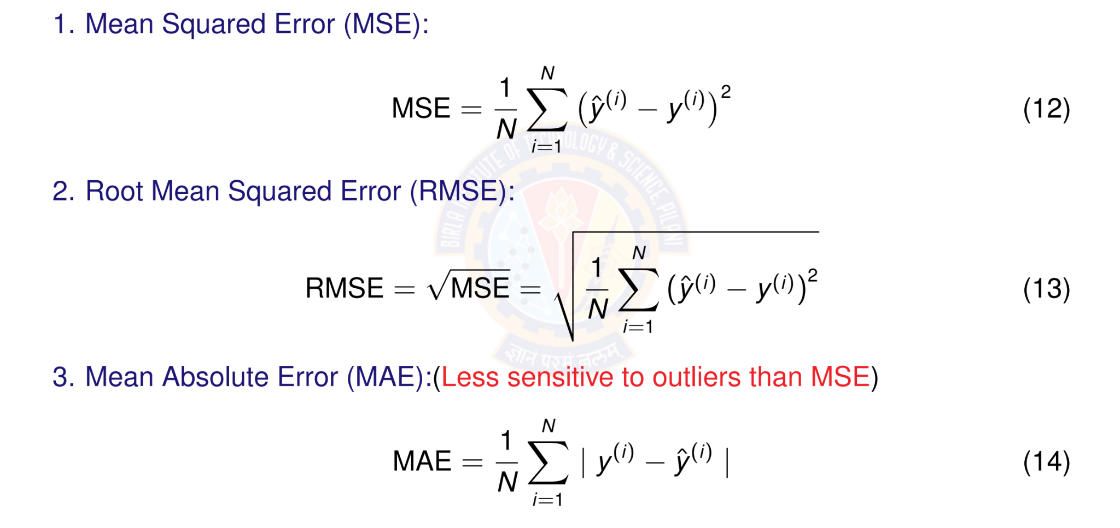
Evaluation Metrics
Deep Learning

Slide 35
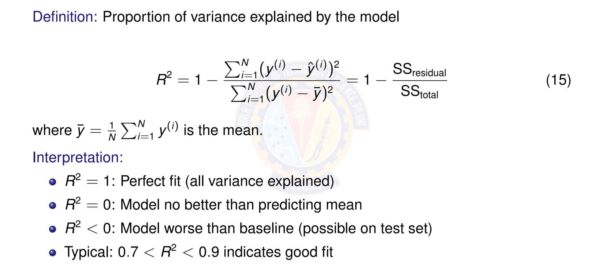
R² Score (Coefficient of Determination)
Deep Learning

Slide 36

Table of Contents
Regression
Linear Regression
The Linear Model: Single Neuron
Worked Example
Evaluation
Python Implementation Implementation Tips
Summary
1
2
3
4
5
6
7
8
Deep Learning

Slide 37
Perceptron Demo Python Code
https://colab.research.google.com/drive/ 10whoZYodz1H02mbVwsmTudwxaU18ukaI?usp=sharing
Student pl note:
The Python notebook is shared for anyone who has access to the link and the access is restricted to use BITS email id. So please do not access from non-BITS email id and send requests for access. Access for non-BITS email id will NOT be granted.
Deep Learning

Slide 38

Table of Contents
Regression
Linear Regression
The Linear Model: Single Neuron
Worked Example
Evaluation
Python Implementation Implementation Tips
Summary
1
2
3
4
5
6
7
8
Deep Learning

Slide 39
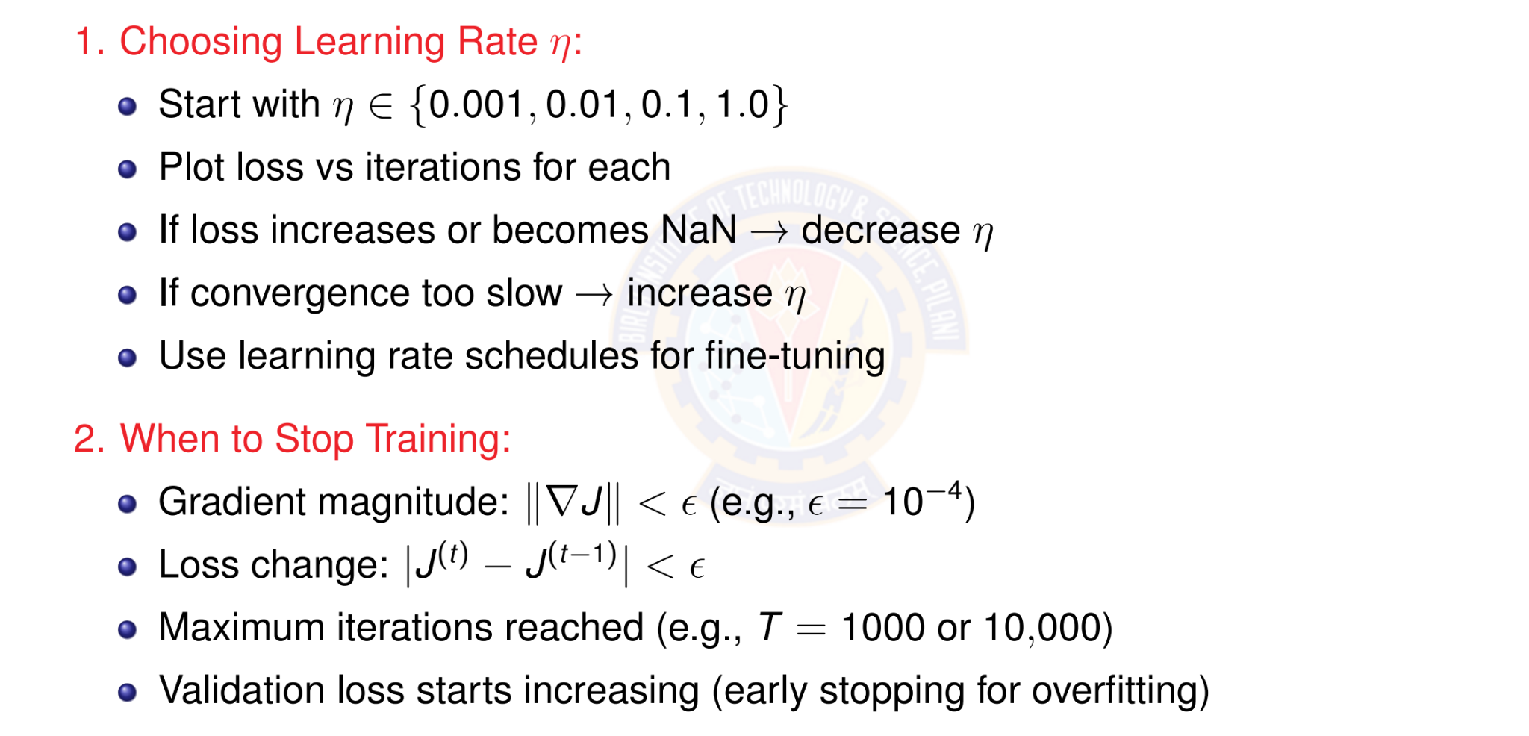
Tips for Implementation
Deep Learning

Slide 40
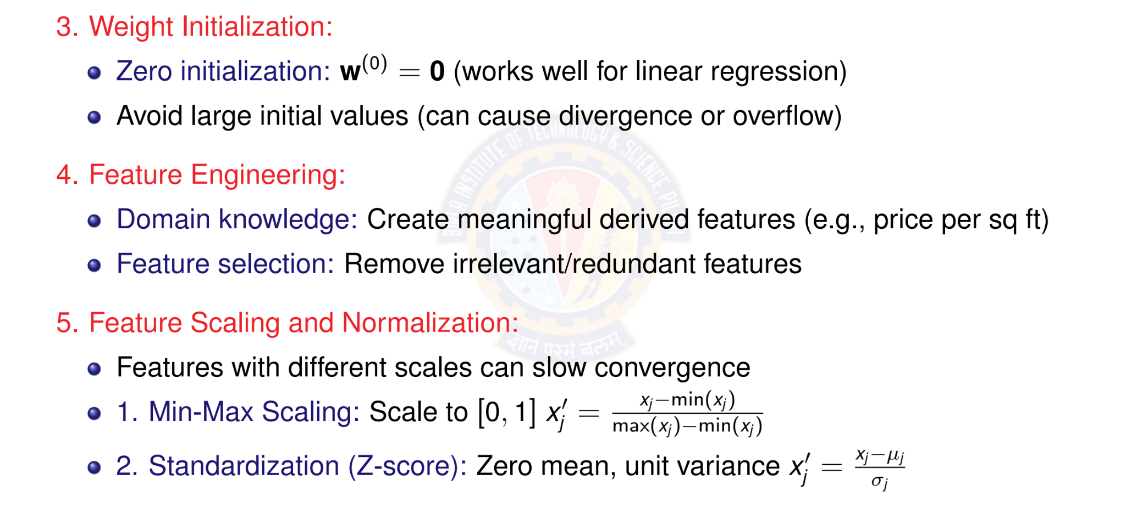
More Practical Tips
Deep Learning
40 / 46

Slide 41
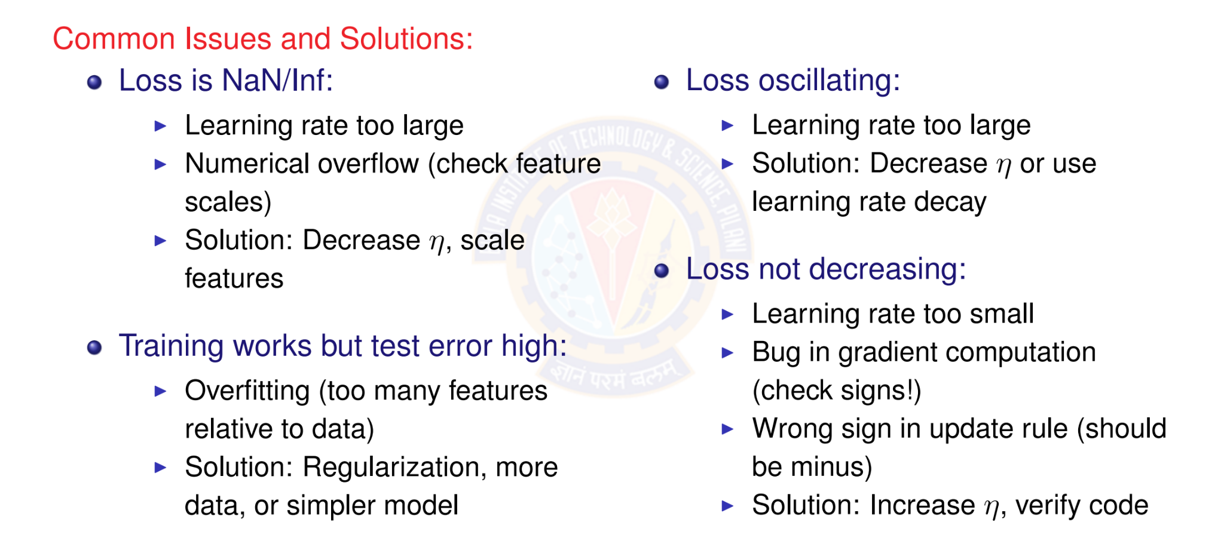
Debugging Checklist
Deep Learning

Slide 42

Table of Contents
Regression
Linear Regression
The Linear Model: Single Neuron
Worked Example
Evaluation
Python Implementation Implementation Tips
Summary
1
2
3
4
5
6
7
8
Deep Learning

Slide 43


Summary: Putting It All Together
1. Data & Initialization
D = {(x^{(i)}, y ^{(i)})}
_{w}(0) ₌ ₀
2. Model
x₁
^{x2} Σ y^{ˆ}
x_{d}
Linear Activation Function
forward
iterate
Linear Regression Model
compute
4. Learning
—η∇J
_{w}(t ) _{w}(t +1)
3. Objective
minimum
J(w)
MSE Loss Function
gradient
This framework extends to more complex models: neural networks, deep learning!
Deep Learning

Slide 44
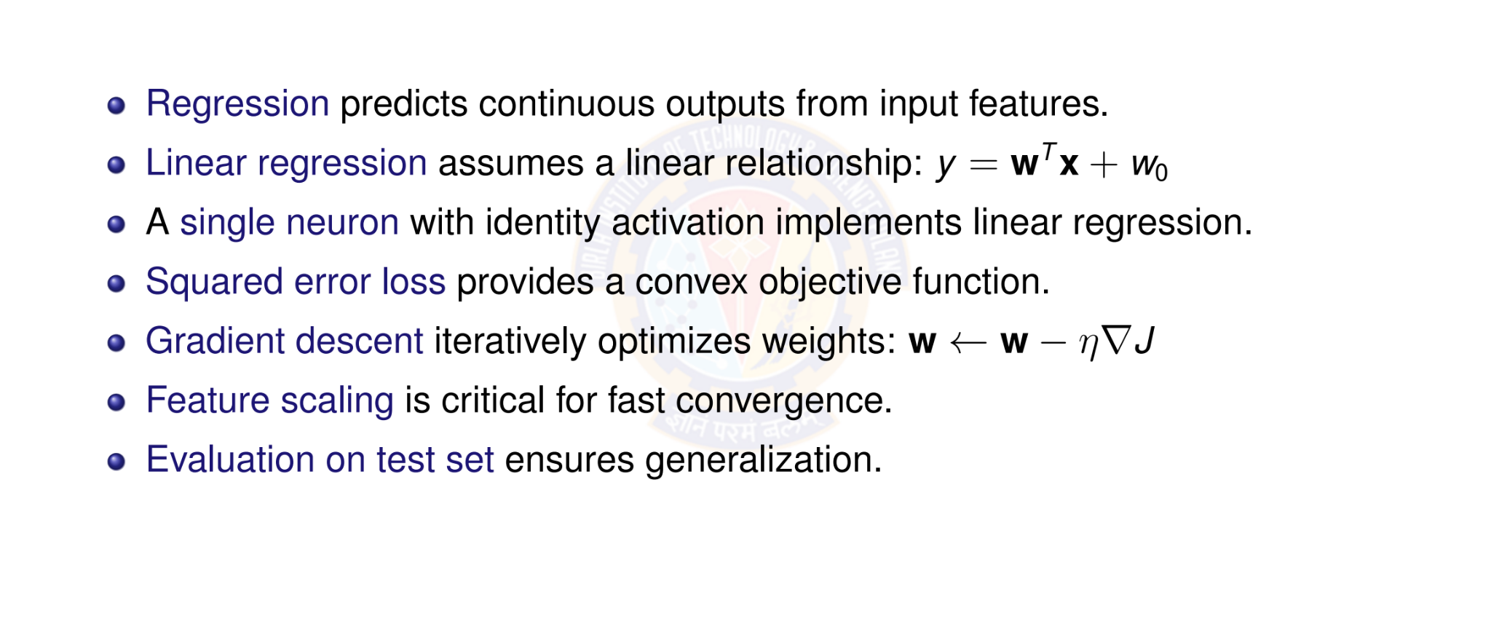
Key Takeaways
Deep Learning

Slide 45
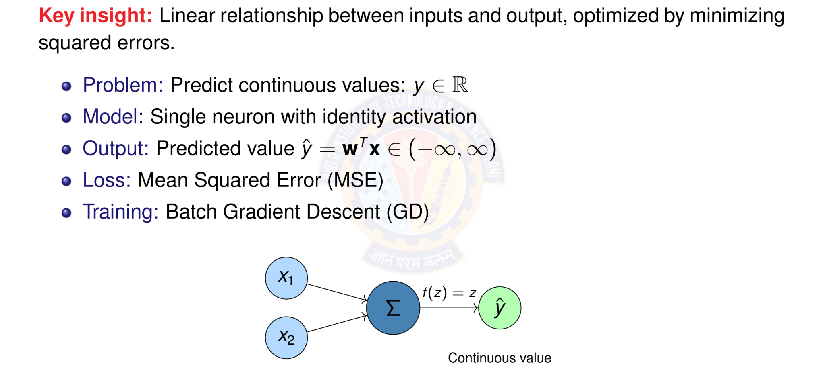
Linear Regression
Deep Learning

Slide 46

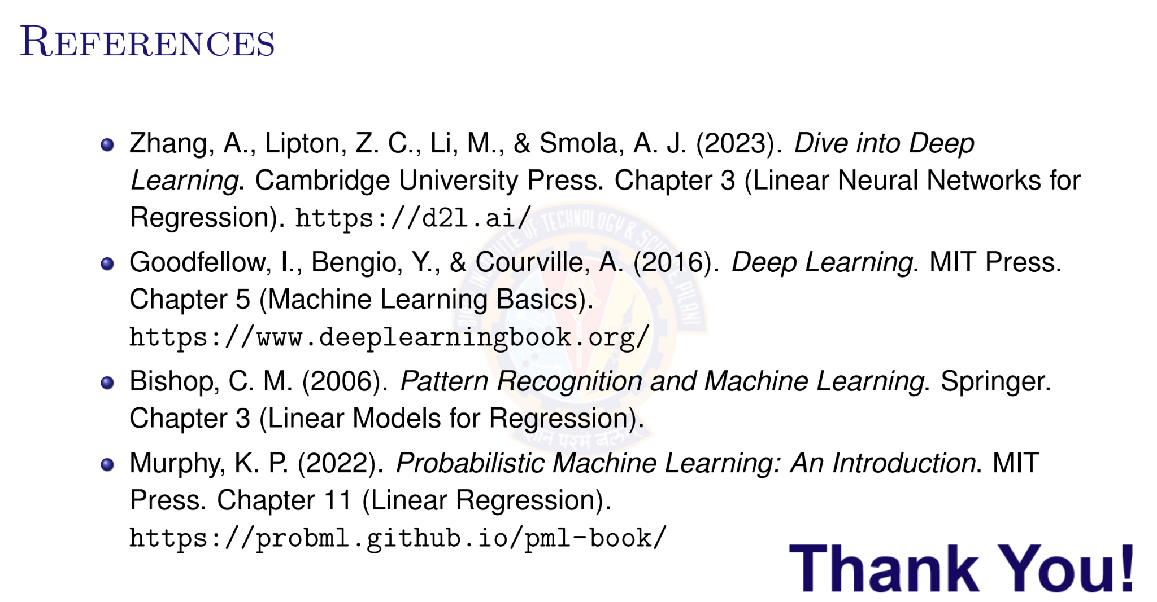
Deep Learning

